Slide 1
西安工程大学 文学系学术答辩 PPT
Xi’an
University of Engineering
Xi'an University of Engineering
author / Meimei Han | Time / 2024.05

Slide 2
Contents
1.
Text here
Supporting text here
2.
Text here
Supporting text here
3.
Text here
Supporting text here
4.
Text here
Supporting text here
5.
Text here
Supporting text here

Slide 3
ONE.
Edit Master text styles
Theme color make s PPT more convenient to change.
Adjust the spacing to adapt to Chinese typesetting, use the reference line in PPT.

Slide 4
“
Text here
Theme color make s PPT more convenient to change.
Adjust the spacing to adapt to Chinese typesetting, use the reference line in PPT.
Theme color make s PPT more convenient to change.Adjust the spacing to adapt to Chinese typesetting, use the reference line in PPT.Unified fonts make reading more fluent.Theme color makes PPT more convenient to change.
Adjust the spacing to adapt to Chinese typesetting, use the reference line in PPT.Theme color make s PPT more convenient to change.Adjust the spacing to adapt to Chinese typesetting, use the reference line in PPT.
Theme color make s PPT more convenient to change.Adjust the spacing to adapt to Chinese typesetting, use the reference line in PPT. Unified fonts make reading more fluent.
Theme color makes PPT more convenient to change.Adjust the spacing to adapt to Chinese typesetting, use the reference line in PPT.……

Slide 5
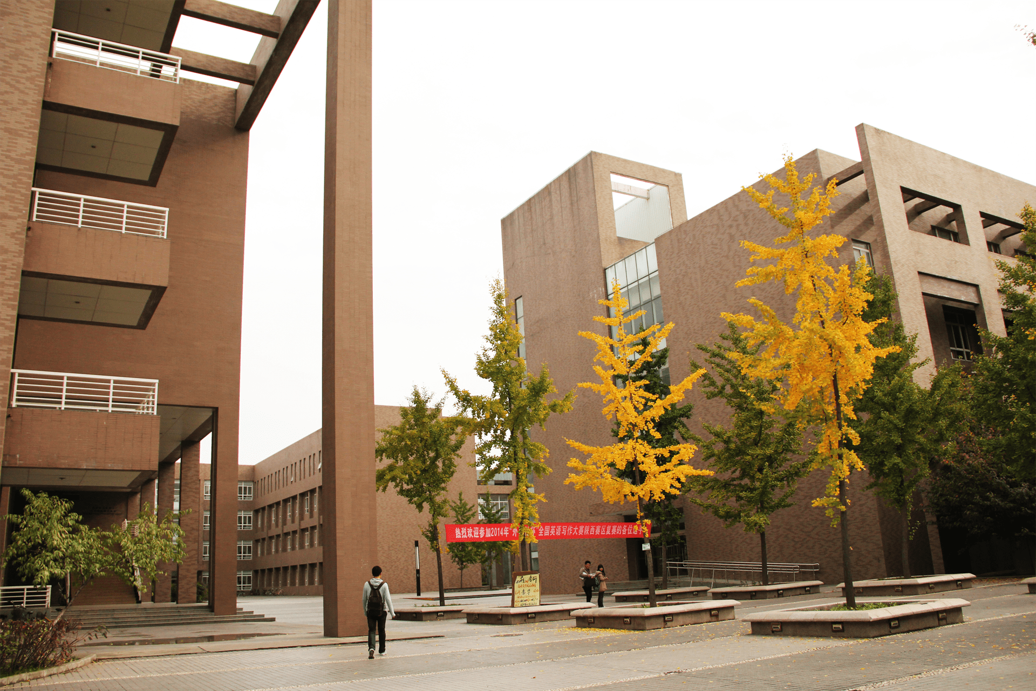
Text here
Theme color make s PPT more convenient to change.
Adjust the spacing to adapt to Chinese typesetting, use the reference line in PPT.
Unified fonts make reading more fluent.
Theme color makes PPT more convenient to change.
Adjust the spacing to adapt to Chinese typesetting, use the reference line in PPT.
……

Slide 6
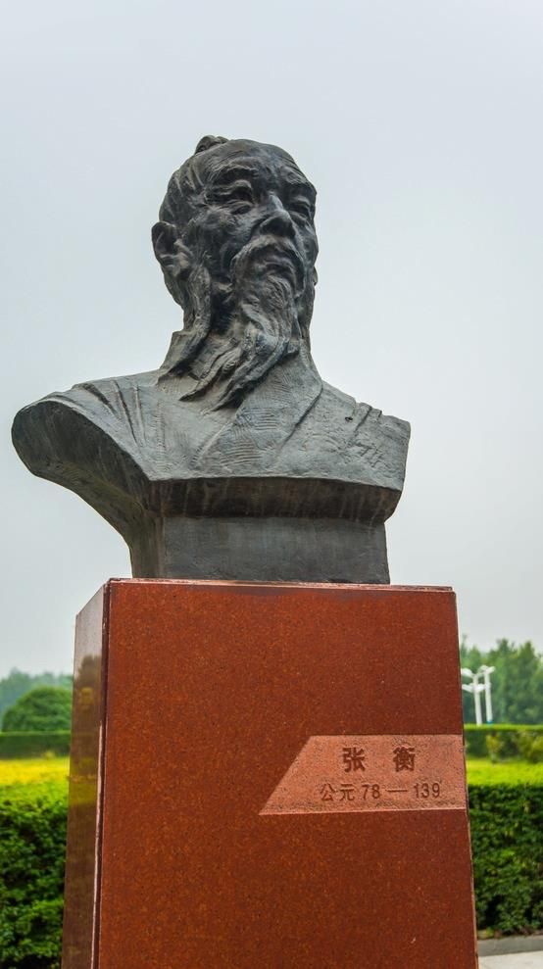
Supporting text here
… …
Text here
Text here
Unified fonts make reading more fluent.
Theme color makes PPT more convenient to change.
Adjust the spacing to adapt to Chinese typesetting, use the reference line in PPT.……
Text here
Theme color make s PPT more convenient to change.
Adjust the spacing to adapt to Chinese typesetting, use the reference line in PPT.
Text here
Theme color make s PPT more convenient to change.
Adjust the spacing to adapt to Chinese typesetting, use the reference line in PPT.

Slide 7
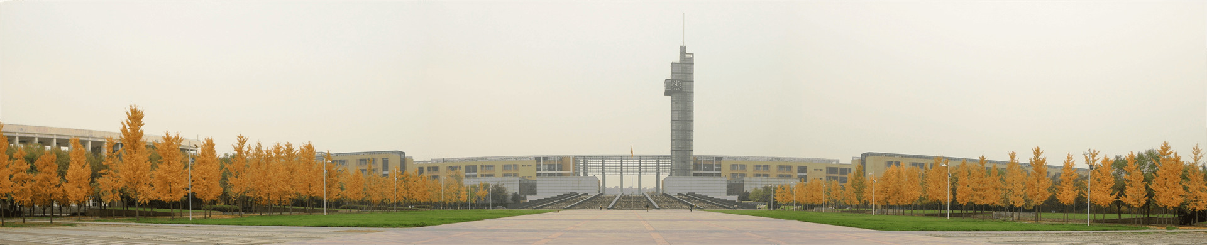
Sup porting text here
Text here
Theme color make s PPT more convenient to change.
Adjust the spacing to adapt to Chinese typesetting, use the reference line in PPT.
Unified fonts make reading more fluent.
Theme color makes PPT more convenient to change.
Adjust the spacing to adapt to Chinese typesetting, use the reference line in PPT.
……

Slide 8
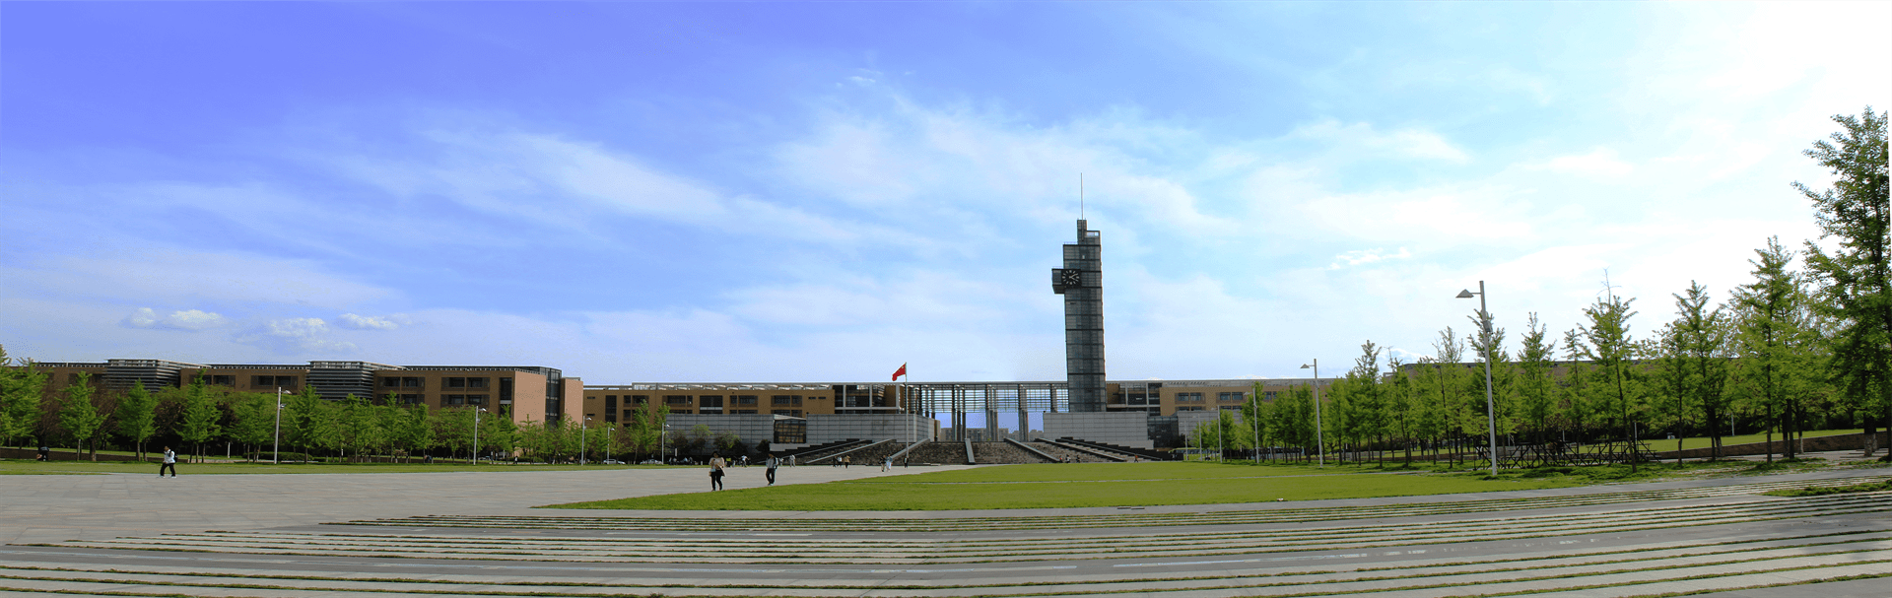
Unified fonts make r eading
more fluent.
Theme color makes PPT more convenient to change.
Adjust the spacing to adapt to Chinese typesetting, use the ref erence line in PPT…… Adjust the spacing to adapt to Chinese typesetting, use the reference line in PPT……

Slide 9
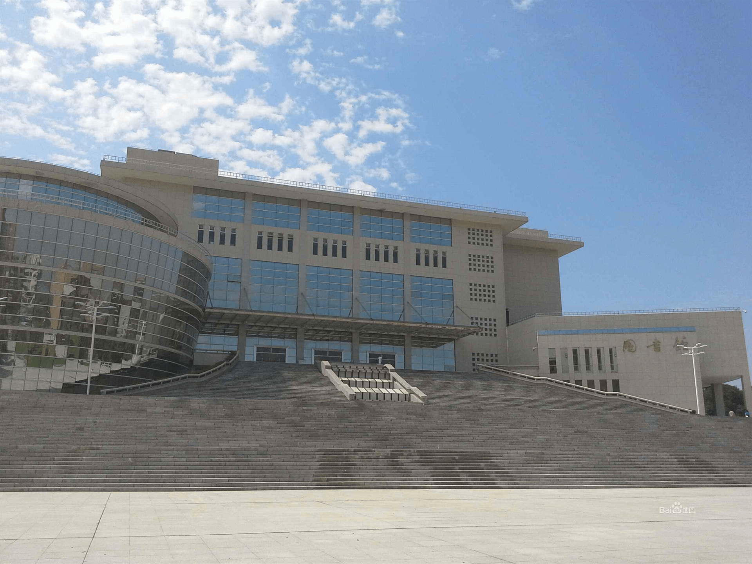
Unified fonts make reading more fluent.
Theme color makes PPT more convenient to change.
Adjust the spacing to adapt to Chinese types etting, use the reference line in PPT……
Text here
Text here
Text here
Text here

Slide 10
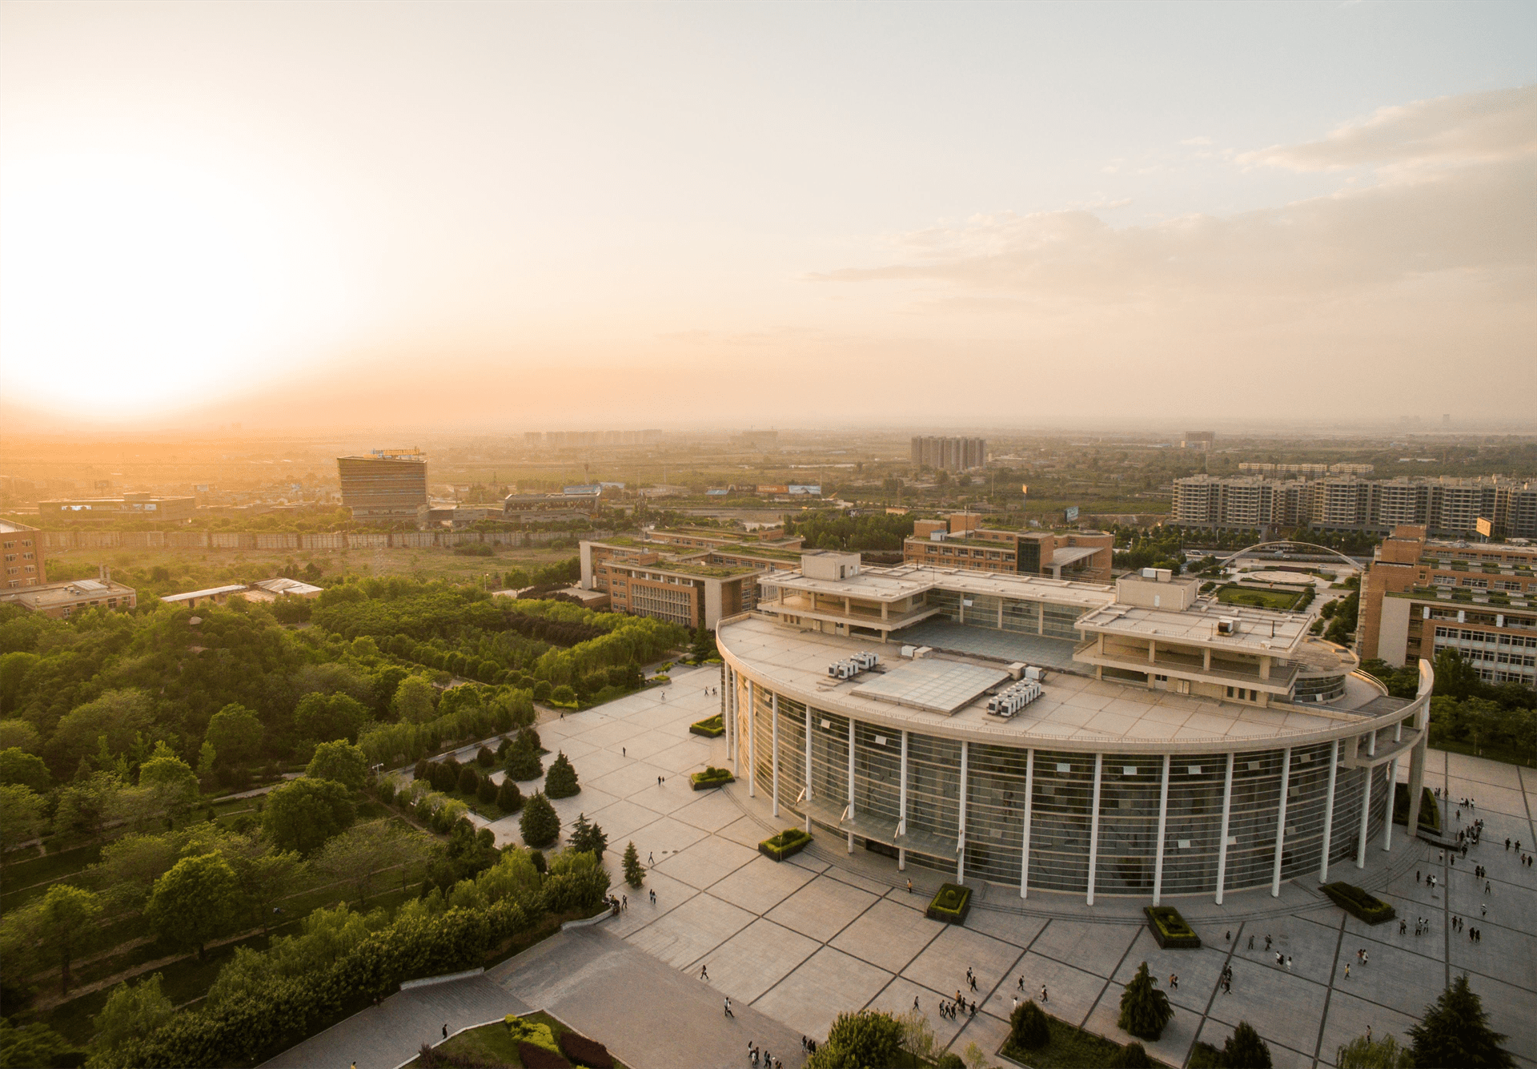
Supporting text here
Text here
Text here
Text here
Unified fonts make reading more fluent.
Theme color makes PPT more convenient to change.
Adjust the spacing to adapt to Chinese typesetting, use the reference line in PPT.
……
Unified fonts make reading more fluent.
Theme color makes PPT more convenient to change.
Adjust the spacing to adapt to Chinese typesetting, use the reference line in PPT.
……
Unified fonts make reading more fluent.
Theme color makes PPT more convenient to change.
Adjust the spacing to adapt to Chinese typesetting, use the reference line in PPT.
……

Slide 11
Suppo rting text here.
Unified fonts m ake
reading more fluent.
Theme color makes PPT more convenient to change.Adj ust
the spacing to adapt to Chinese typesetting, use the reference
line in PPT.
Text here
48%
77%
Text here
40%
90%

Slide 12
6 5%
Supporting text here.
Unified fonts make rea ding more fluent.
Unified fonts make reading more fluent.Theme color makes PPT more convenient to change.
Adjust the spacing to adapt to Chinese typesetting, use the reference line in PPT.

Slide 13
“
Text here
Theme color make s PPT more convenient to change.
Adjust the spacing to adapt to Chinese typesetting, use the reference line in PPT.
Unified fonts make reading more fluent.Theme color makes PPT more convenient to change.
Adjust the spacing to adapt to Chinese typesetting, use the reference line in PPT.
……
Theme color make s PPT more convenient to change.
Adjust the spacing to adapt to Chinese typesetting, use the reference line in PPT.
Unified fonts make reading more fluent.Theme color makes PPT more convenient to change.
Adjust the spacing to adapt to Chinese typesetting, use the reference line in PPT.
……

Slide 14
Supporting text here Supporting text here … …
Text here
50%
38%
73%
57%
94%
Category
Category
Category
Category
Category
Unified fonts make reading more fluent.
Theme color makes PPT more convenient to change.
Adjust the spacing to adapt to Chinese typesetting, use the reference line in PPT.
……

Slide 15
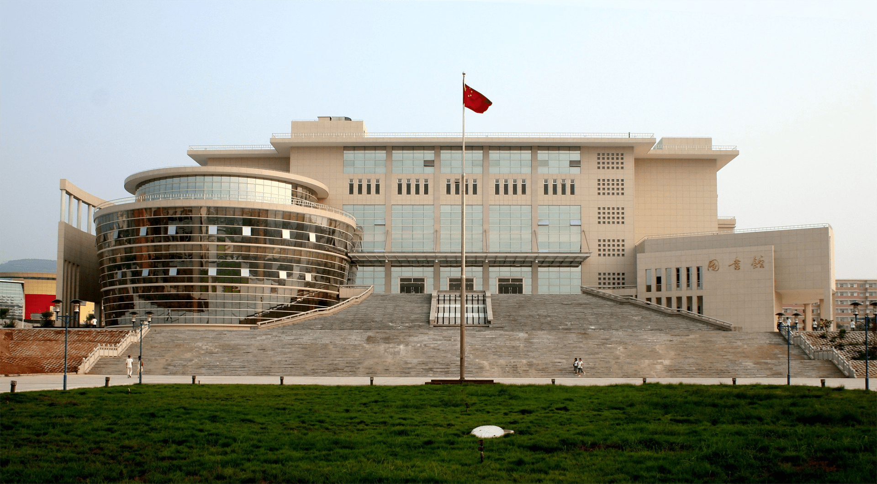
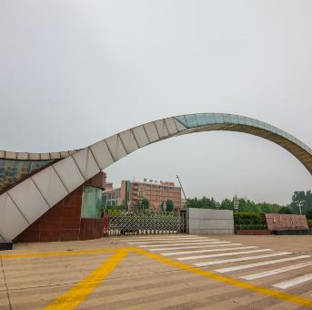
Unifi ed fonts
make reading more fluent.
Theme color make s PPT more convenient to change.
Adjust the spacing to adapt to Chinese typesetting, use the reference line in PPT……

Slide 16
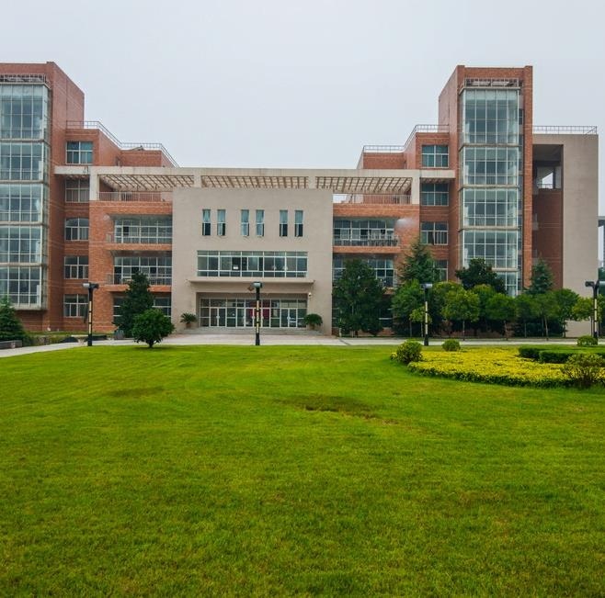
Supporting text here Supporting text here … …
Text here
63%
Text here
Supporting text here
19%
Supporting text here.
Unified fonts make rea ding more fluent.
Text here
Supporting text here

Slide 17
Unif ied fonts make reading
more fluent.
Theme color makes PPT more convenient to change.
Adjust th e spacing to adapt to Chinese typesetting, use the reference line in PPT……

Slide 18
Supporting text here Supporting text here … …
Text here
42%
Category
67%
Category
23%
Category
71%
Category

Slide 19
Supporting text here Supporting text here … …
Text here
Text here
Support ing text here
Text here
5 0%
Support ing text here
6 8%
Text here
Support ing text here
2 4%

Slide 20
Unified fonts make reading more fluent.
Theme color makes PPT more convenient to change.
Adjust the spacing to adapt to Chinese typesetting, use the reference line in PPT.
Text here
Text here
Text here
Supporting text here.
… …
Supporting text here.
… …
Supporting text here.
… …

Slide 21
Edit Master text styles
Text here
Unified fonts make reading more fluent.
Text here
Theme color makes PPT more convenient to change.
Text here
Adjust the spacing to adapt to Chinese typesetting, use the reference line in PPT.

Slide 22
Supporting text he re.
Unified Fonts Make
Reading More F luent.
Unified fonts make reading more fluent.
Theme color makes PPT more convenient to change.
Adjust the spacing to adapt to Chinese typesetting, use the refer ence line in PPT.
……

Slide 23
Unified fonts make reading
more flu ent.
0 1
Theme color makes PPT more convenient to change.
Adjust the spacing to adapt to Chinese typesetting, use the reference line in PPT……
Unified fonts make reading more fluent.
Theme color makes PPT more convenient to change.
Adjust the spacing to adapt to Chinese typesetting, use the reference line in PPT.

Slide 24
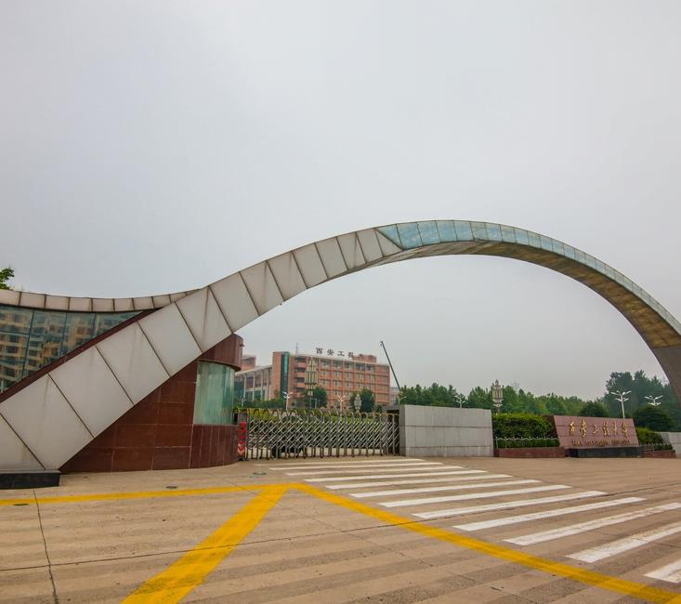
Supporting text here Supporting text here … …
Text here
Text here
Theme color makes PPT more convenient to change.
Adjust the spacing to adapt to Chinese typesetting, use the reference line in PPT……

Slide 25
Sup porting text here Sup porting text here
Text here
Unified fonts make reading more fluent.
Theme color makes PPT more convenient to change.
Adjust the spacing to adapt to Chinese typesetting, use the reference line in PPT.
……

Slide 26
Unified fonts make r eading
more fluent.
Theme color makes PPT more convenient to change.
Adjust the spacing to adapt to Chinese typesetting, use the ref erence line in PPT…… Adjust the spacing to adapt to Chinese typesetting, use the reference line in PPT……

Slide 27
P PT
Un ified fonts
make reading more fluent.
Theme color makes PPT more convenient to change.
Adjust the spacing to adapt to Chinese ty pesetting, use the reference line in PPT……
Theme c olor makes PPT more convenient to change.
Adjust the spacing to adapt to Chinese typesetting, use the reference line in PPT……

Slide 28
Unified fonts make reading more fluent.

Slide 29
THANKS
Theme color makes PPT more convenient to change.
Adjust the spacing to adapt to Chinese typesetting, use the reference line in PPT……

